Slide 1

Cardiovascular Disorders
Heart Failure
Name
Institution Affiliation
Course
Date

Slide 2
Heart failure
This is a condition that happens when the heart muscles become powerless and cannot pump blood efficiently to other body parts as they should.
  Particular conditions such as high blood pressure and narrow arteries may cause the heart muscles to weaken gradually.
It is a life threatening syndrome with high mortality rates among patients.
  The condition is a huge burden to healthcare systems, patients, and care- givers

Slide 3
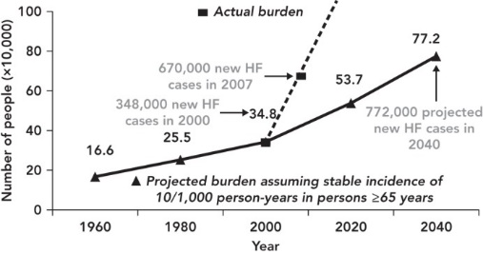
Incidence of Heart Failure
Based on a study done by Nathalie Conrad and others on a population of 4 million people in the U.K;
    7% reduction was noted from 2002 to 2014
    The number stood at 332 from 358 per 100,000 person-years.
    Incidence had however increased for people older than 85 years (Zannad, 2018, p. 518).
Savarese & Lund, 2017, p. 8
Notes:
The figure above shows the incidence of heart failure in the US.
Heart failure is a common type of condition among the elderly, Approximately 960 new cases are diagnosed in the U.S each year.
Incidence of HF among 656 years and older patients is 21 in a population of a thousand.

Slide 4
Prevalence of Heart Failure
37.7 million people were living with Heart failure at 2016.
  Prevalence in developing countries was estimated at 1-2 % of the adult population.
Prevalence in the USA various due to factors such as geographical location, ethnicity, and the socio economic status.
Despite few reliable sources of information from developing nations, numerous literature sources conclude that heart failure is fast growing globally.
Notes:
Lower socioeconomic status is associated with higher rates of HF when controlling for known cardiovascular risk factors
African–American individuals have a threefold increased risk of developing dilated cardiomyopathy when controlling for socioeconomic factors and comorbidities

Slide 5
Pathophysiology
In HF, the heart doesn't give adequate blood as required for metabolic requirements by the tissues.
This condition may result from systolic or diastolic capacity aggravations or, for the most part, both.
The fundamental or systemic venous weight rises related with cardiovascular breakdown may bring about organ congestion.
While a change in cardiomyocyte capacity might be a key anomaly, there are additional varieties in the extracellular framework's collagen turnover.
(Kirali et al., 2017)
Notes:
Heart failure occurs from myocardial damage from a number of causes, including, hypertension, diabetes and ischemic heart disease.
Myocarditis, Cardiomyopathies, valvular disease, and infections are less prevalent etiologies.
When the heart fails, patients experience symptoms that include pulmonary obstruction dyspnea, peripheral edema and reduced venous return ascites.
Constitutional symptoms are also common, such as nausea, loss of appetite and exhaustion.

Slide 6
Pathophysiology (Cellular Changes)
The cellular changes that occur in Heart Failure include.
      abnormalities in calcium balance
      myocyte hypertrophy
      cytoskeletal architecture changes
      excitation-contraction coupling
(Kirali et al., 2017)
Notes:
The heart is a self-renewing organ which during pathological stress, is characterized by an increase in myocyte turnover rate, especially in heart failure.
A faster loss of myocytes overwhelms the turnover process, and this unfavorable imbalance triggers ventricular remodeling progression throughout heart failure.
Hemodynamic and neurohormonal changes produce a rise in the consumption of cytosolic calcium, which increases myocardial contractility.
Irreversible pathologies result in gradual loss of contractile control and myofilaments , as well as changes in the coupling of excitation-contraction, fatal arrhythmias, and ß-adrenergic signaling desensitization.

Slide 7
Role of Nurses in Heart failure
Quick triage to the required and appropriate environment for maximum care.
Objective evaluation of changes in signs and symptoms that indicate a reaction to treatment.
Discharge planning and relation to the multidisciplinary programme for disease management
The patient's distress should be handled by answering questions immediately and presenting the patient and family with accurate details.
Riley, 2015, p. 124
Notes:
Acute heart failure patients benefit from early diagnosis, close supervision and treatment provided by trained teams of heart failure clinicians and cardiology ward nurses with proper education to encourage safe practice.
The heart failure nurse specialist is best positioned as part of the team to also provide patients with an outreach program in the acute heart failure pathway, and this includes close coordination with nurses in specialist areas of non-cardiology such as the emergency department and general medical/elderly care wards.

Slide 8
Management of Heart Failure
Main goals during treatment:
Improve the rate of prognosis among patients and lower the mortality rate.
Alleviating the symptoms that come with HF and lower the morbidity
  Morbidity is lowered by slowing or reversing the peripheral and cardiac dysfunction.
Measures taken include:
Monitoring oxygen levels
noninvasive positive pressure ventilation should be provided when required.
Use of pharmacological agents such as diuretics and Beta-adrenergic blockers
(Inamdar & Inamdar, 2016, p. 7)
Notes:
In addition to the above objectives, other therapy objectives for in-hospital patients are
to reduce the length of stay and subsequent readmission
to prevent damage to the organ system and
to properly manage the co-morbidities that may contribute to poor prognosis

Slide 9
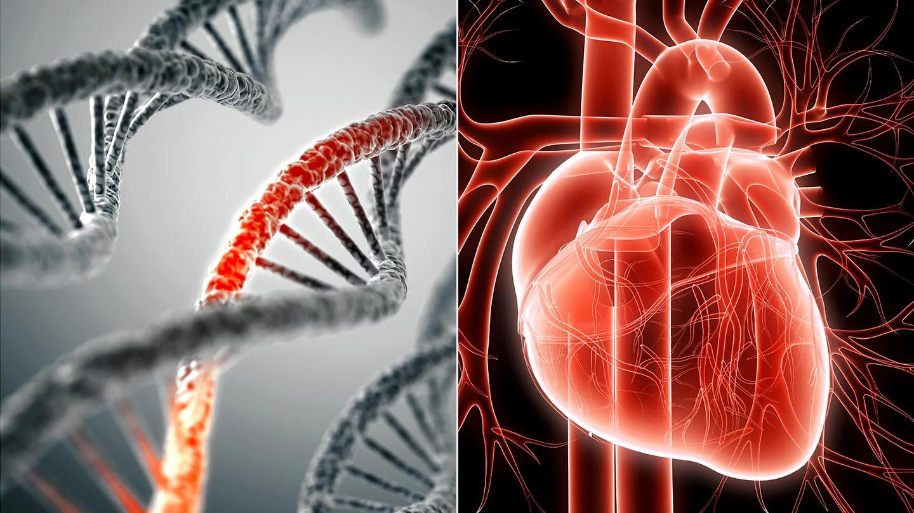
Genetics and Heart Failure
There is a clear linkage between gene mutations and heart failure.
The genetic predisposition (underlying genetic mutations and variants) determine the risks and the course of HF.
Highly heterogeneous and complex is genetic contribution to heart failure.
Genetic counseling is recommended and essential for any patient with a likely inherited syndrome of heart failure.
Czepluch et al., 2018, p. 211
Notes:
There is a clear linkage between gene mutations and heart failure.
The genetic predisposition (underlying genetic mutations and variants) determine the risks and the course of HF.
Highly heterogeneous and complex is genetic contribution to heart failure.
Genetic counseling is recommended and essential for any patient with a likely inherited syndrome of heart failure.

Slide 10


Patient Education for Management
Diet and Nutrition
Rest and Exercise
Improve self-care behavior
Avoiding Tobacco
Drug Counselling
Notes:
Most of the effective disease management systems are multi-faceted and consist of an in-hospital treatment process, patient education, self-supporting plan for self-care, medical regimen optimization, and ongoing monitoring and clinical deterioration management.
In these creative modes of treatment, nurses and other healthcare professionals may play an important role.
It is a challenge for both healthcare professionals and researchers to evaluate in the near future the best strategy for the education and follow-up of chronic HF patients.

Slide 11

Culture and Religion
When handling patients with heart attack, it is important to take into consideration their culture and spirituality.
In order to do this various steps must be taken. These include:
        Motivating families to engage in decision-making on wellness
        Incorporating principles unique to culture into health promotion
        Giving support for cultural sensitivity
Notes:
Health services should be mindful of the religious and moral needs of a patient.
When they turn to their faith during healthcare struggles, many patient anxieties are lessened.
when challenging health care decisions are made, many patients turn to their values, it is important for healthcare professionals to understand and meet the religious and spiritual needs of the patient.

Slide 12
Heart Failure in Children
When HF occurs in children it is caused mainly by congenital heart defects that the child is born with.
Infections and other medical issues may also lead to a heart attack.
Such a heart failure may affect the left or right side of the heart.
Symptoms include:
    Poor growth
    Heavy breathing
    Falling asleep during meals
    Swelling of limbs
    (Boston children hospital, n.d.)
Notes:
Other effects include:
If the blood supply to the brain is blocked by a clot, a stroke may happen.
Low amount of red blood cells or low level of hemoglobin
Damage to organs in the kidney or liver

Slide 13
References
Boston children hospital. (n.d.). Heart failure in children. Boston Children's Hospital. https://www.childrenshospital.org/conditions-and-treatments/conditions/h/heart-failure
Czepluch, F. S., Wollnik, B., & Hasenfuß, G. (2018). Genetic determinants of heart failure: Facts and numbers. ESC Heart Failure, 5(3), 211-217. https://doi.org/10.1002/ehf2.12267
Inamdar, A., & Inamdar, A. (2016). Heart failure: Diagnosis, management and utilization. Journal of Clinical Medicine, 5(7), 62. https://doi.org/10.3390/jcm5070062
Kirali, K., Ozer, T., & Ozgur, M. M. (2017). Pathophysiology in heart failure. Cardiomyopathies - Types and Treatments, 17-38. https://doi.org/10.5772/66887
Riley, J. (2015). The key roles for the nurse in acute heart failure management. Cardiac Failure Review, 1(2), 123. https://doi.org/10.15420/cfr.2015.1.2.123
Savarese, G., & Lund, L. H. (2017). Global Public Health Burden of Heart Failure. Cardiac Failure Review, 3(1), 11-7. https://doi.org/10.15420/cfr.2016:25:2
Zannad, F. (2018). Rising incidence of heart failure demands action. The Lancet, 391(10120), 518-519. https://doi.org/10.1016/s0140-6736(17)32873-8

